Slide 1
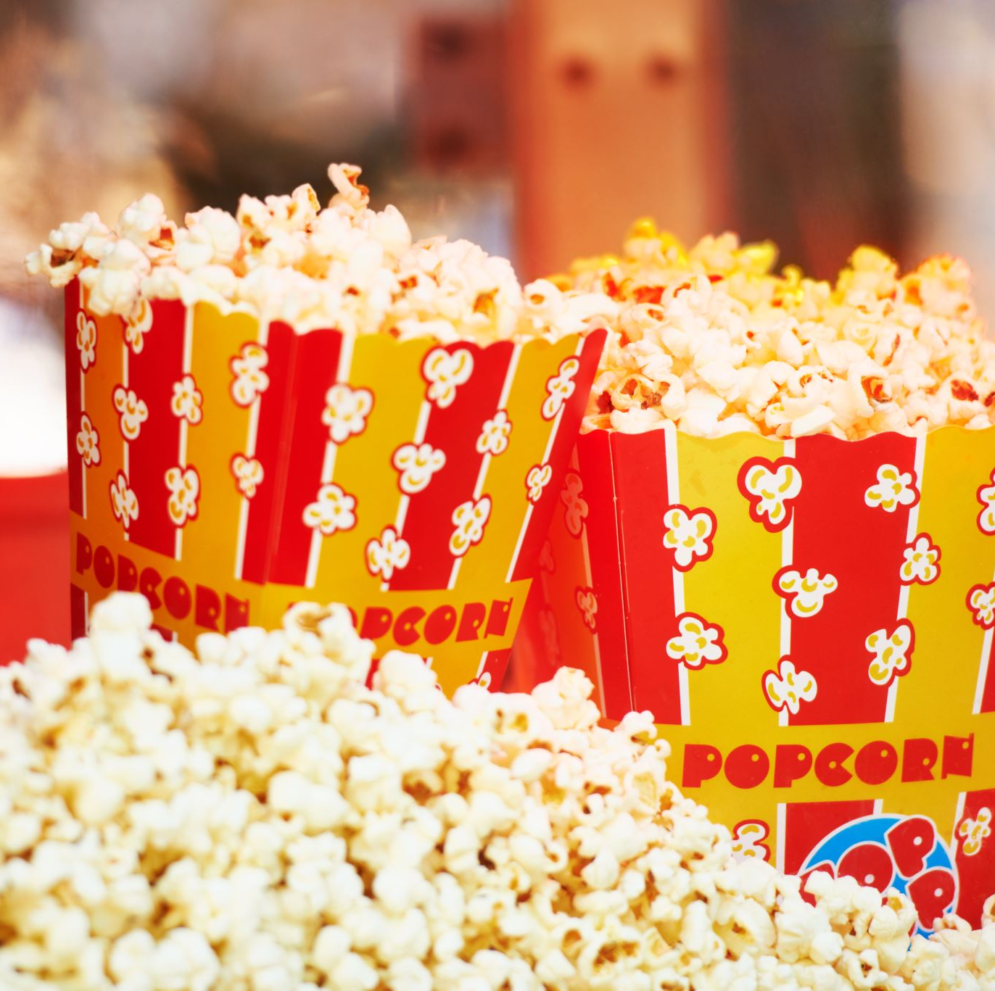
Movie recommendation system using r
Apoorva Anumalla
Harsh Natvarlal Sindhwa
Rajani Kumari Jangiti
Vamshi Reddy Komatireddy

Slide 2
contents
What is a movie recommendation system?
About the dataset
Exploratory data analysis
Model Creation and Working
Conclusion
Future scope

Slide 3
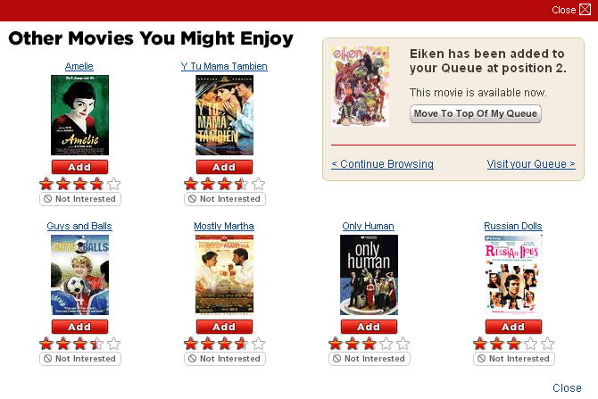
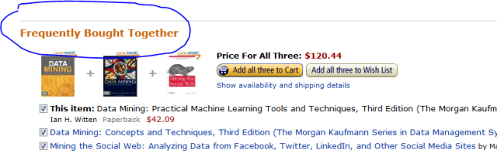
What is a recommendation system
A facility that has an extensive class of Web Applications and involve in predicting user responses is known as a Recommendation system.
These systems are algorithms aimed at suggesting relevant items to users.
The best examples are Youtube, Netflix and Amazon.
Recommendation Systems can be classified into two kinds:
Content based filtering
Collaborative based filtering
Of the two methods, for our project, we have created a Content based recommendation system.

Slide 4

Why do we need a recommendation system???
With an overwhelming number of choices on the internet, there arises the need to filter, prioritize and efficiently deliver relevant information to the user.
Information overload problem is solved by search engines, but they do not provide personalization of data. Recommendation engines provide personalization.

Slide 5
dAtaset
We chose the movie dataset available over the internet and can be accessed through the link http://files.grouplens.org/datasets/movielens/ml-10m.zip
The dataset is huge and consists of 100,000 rows.
The important features in the dataset are:
100,000 ratings
3,600 tag applications
9,000 movies
600 users

Slide 6
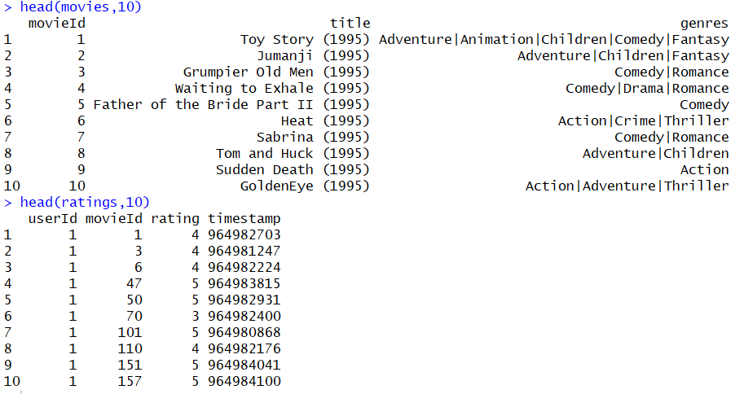

Slide 7
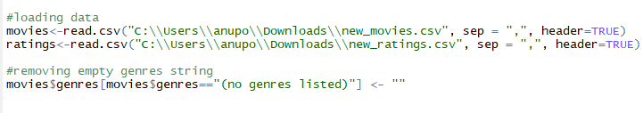
Data cleaning
The data was pretty clean and did not require further cleaning.
However, there were notable rows where the genre column of few movies was empty.
We removed the empty values and replaced them with “No genres listed”
The screenshot above displays the code snippet for the performed data cleaning.

Slide 8
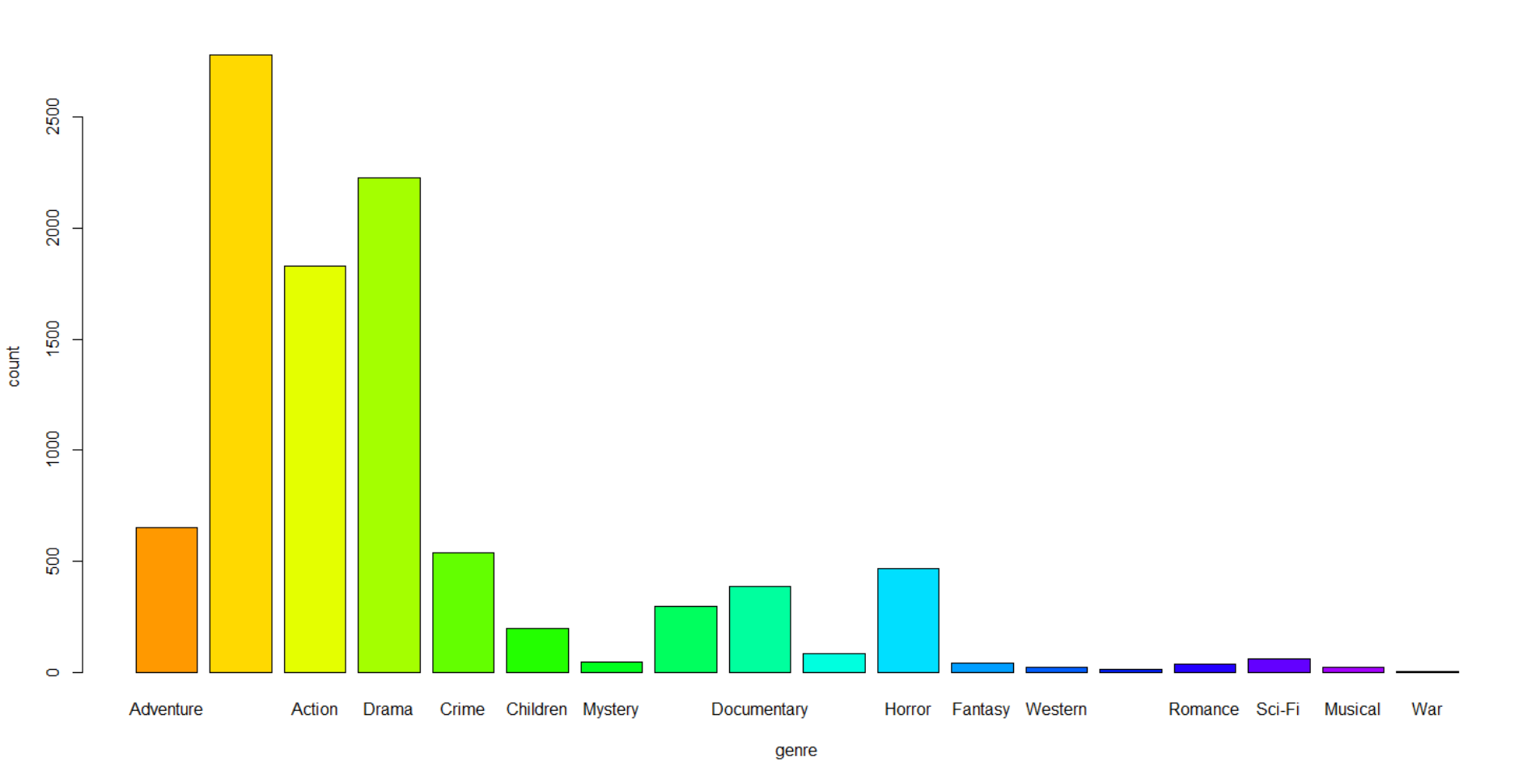
Exploratory data analysis
Most Popular Genres of movie released

Slide 9
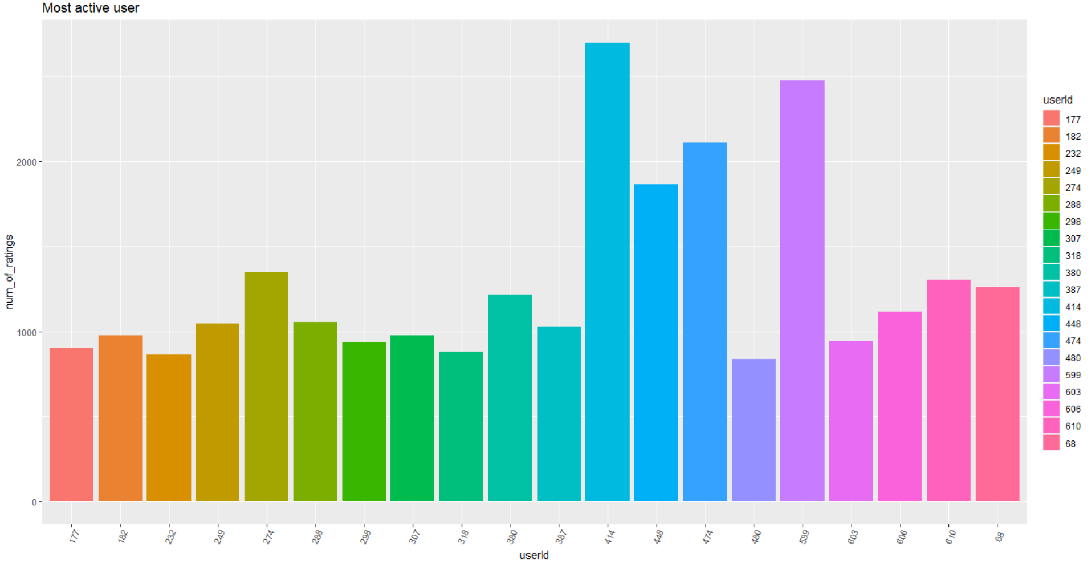

Slide 10
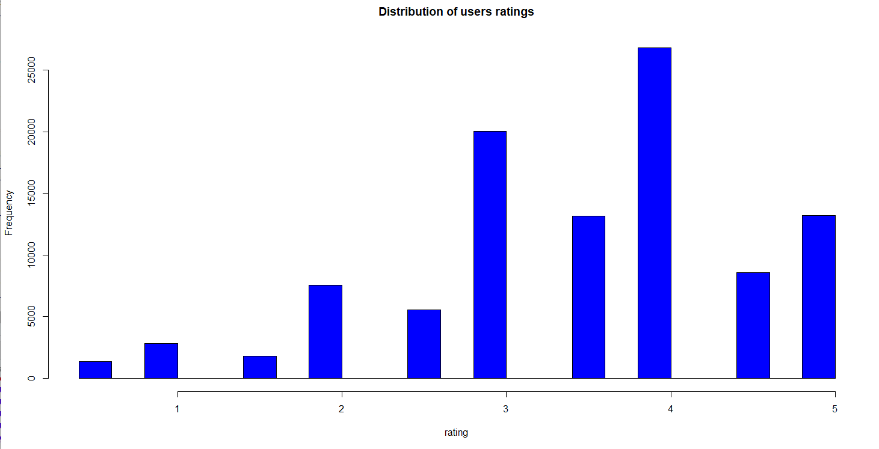
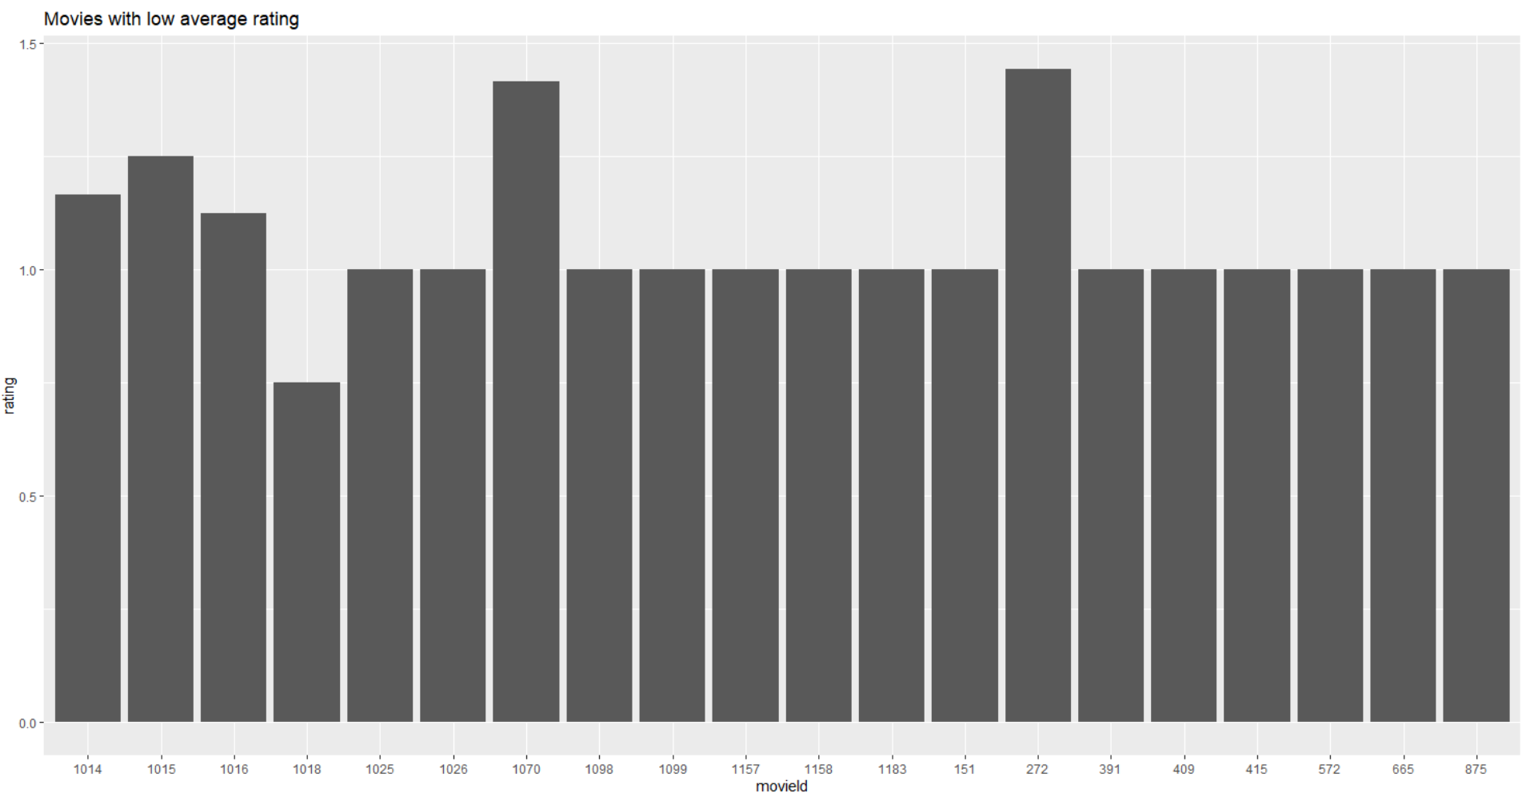
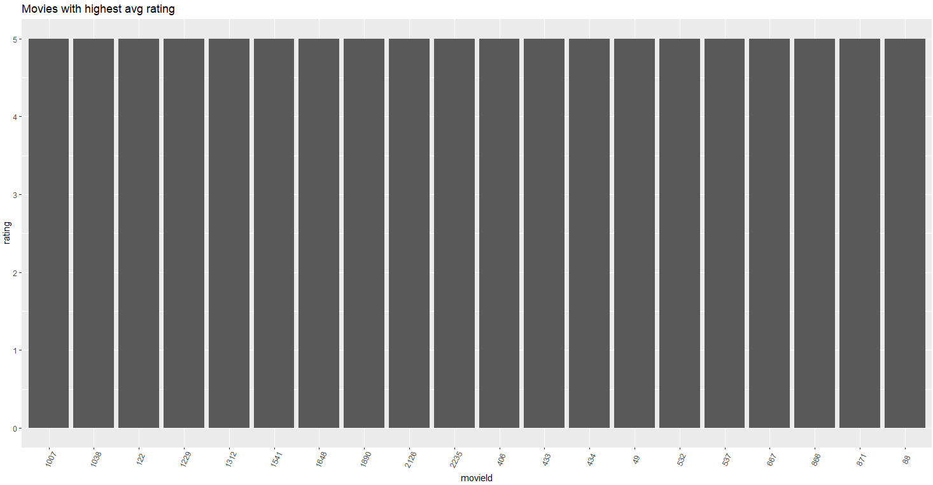

Slide 11
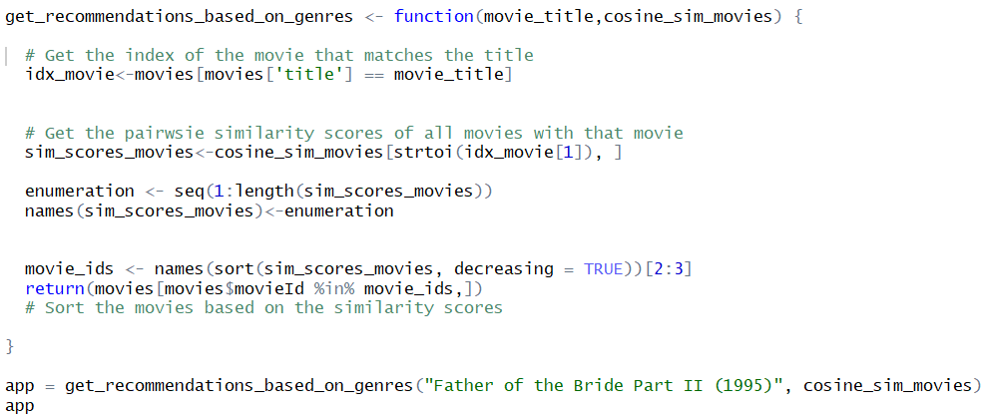
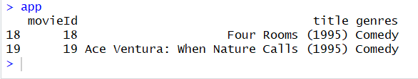

Slide 12
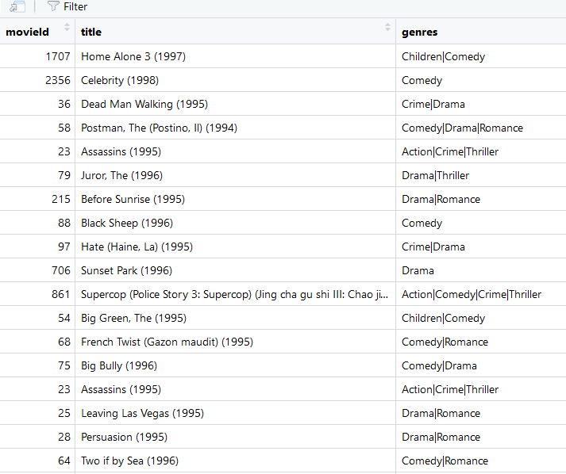
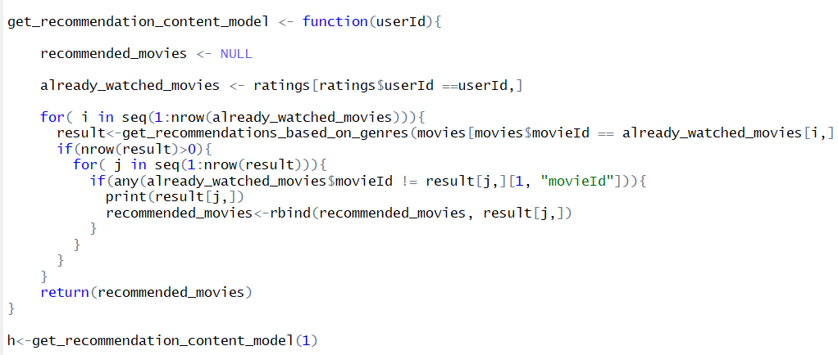
Recommendation for a user

Slide 13
Model Creation and working
To evaluate our system, we need to implement a machine learning model.
We chose to implement the KNN classifier for movie prediction.
The model is evaluated on whether there is an exact match of the genres of the movie which is pre-watched by the user.

Slide 14
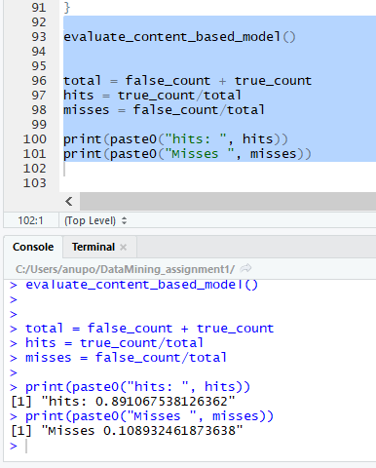
Model evaluation
We evaluated the content based model and gained an accuracy of 89%
The screenshot to the right depicts the ‘hits’ and ‘misses’ percentage

Slide 15

conclusion
Here are the insights from the work we did on this dataset:
Most of the movies belonged to the ‘Comedy’ and ‘Drama’ genres.
Advantage of content based filtering:
Regardless of the rating of the movie, recommendations can be made based on content and genre.
Disadvantage of content based filtering:
For a new user, with no prior data, the recommendations are clueless.
This Photo by Unknown Author is licensed under CC BY-NC

Slide 16
Future scope
Deep Learning can utilize Recurrent Neural Network and thus build an accurate recommendation system.
1
Can perform cross validation of the data that enhances the working of the model.
2
Natural Language Processing can help in gaining better results for content-based recommendation.
3
Collaborative based recommendation system can be built and comparison can be performed.
4

Slide 17
reference
Tanner, G. (2019, February 12). Building a book Recommendation System using Keras. Retrieved May 15, 2020, from https://towardsdatascience.com/building-a-book-recommendation-system-using-keras-1fba34180699
Deep Learning based Recommender System: A Survey and New ... (n.d.). Retrieved May 15, 2020, from https://arxiv.org/pdf/1707.07435.pdf
Kordík, P. (2019, December 15). Machine Learning for Recommender systems - Part 1 (algorithms, evaluation and cold start). Retrieved May 15, 2020, from https://medium.com/recombee-blog/machine-learning-for-recommender-systems-part-1-algorithms-evaluation-and-cold-start-6f696683d0ed
Isinkaye, F., Folajimi, Y., & Ojokoh, B. (2015, August 20). Recommendation systems: Principles, methods and evaluation. Retrieved May 15, 2020, from https://www.sciencedirect.com/science/article/pii/S1110866515000341

Slide 18


